Slide 1
Parents Reading Workshop
Welcome
Why is reading so important?
Is reading regular at home?
Do you know how to improve your child’s reading
ability?
Do you know how to improve your child’s
understanding of reading?
What reading support is offered in school?
Any questions?

Slide 2
Good literacy skills provide us with the building blocks not just for academic success, but for fulfilling careers and rewarding lives.
Children learn on average 7-8 new words a day
A child who enters school in the lowest 20% of vocabulary knowledge will need to learn 20 new words, every day for the next 3 years to catch up (Biemillar, 2011)
Hart and Risley(2005) suggest that children need to hear and use new vocabulary at least 6 times in a context that is meaningful to them in order to be able to say it.
A child’s reading ability indicates their future success and life chances more than any other indicator such as socio-economic status.

Slide 3
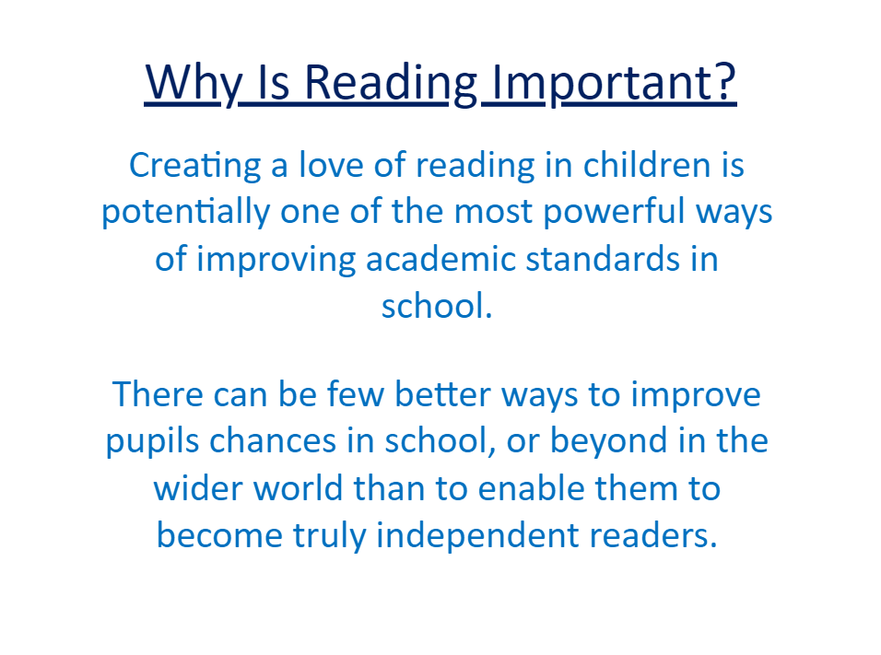

Slide 4
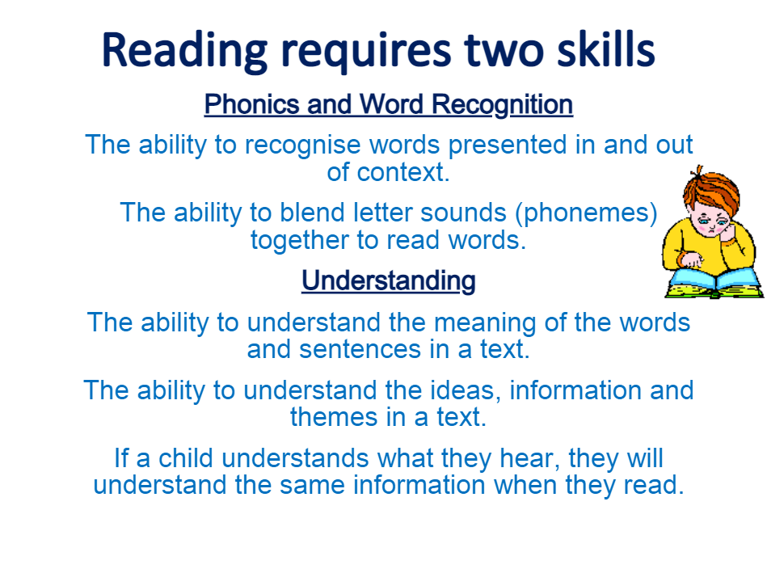

Slide 5
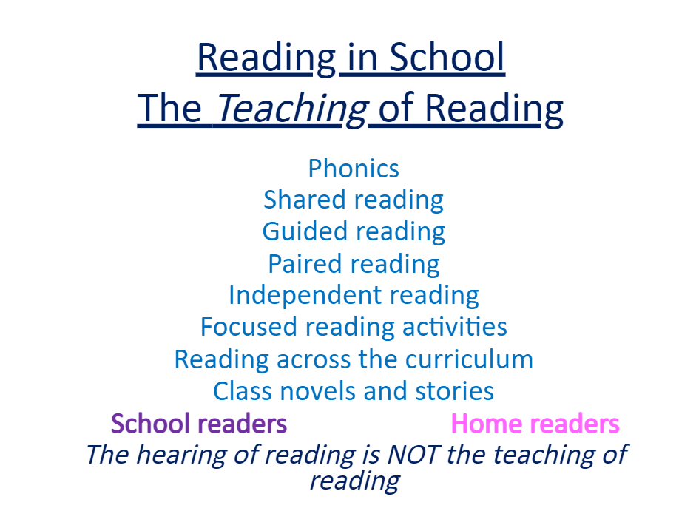

Slide 6
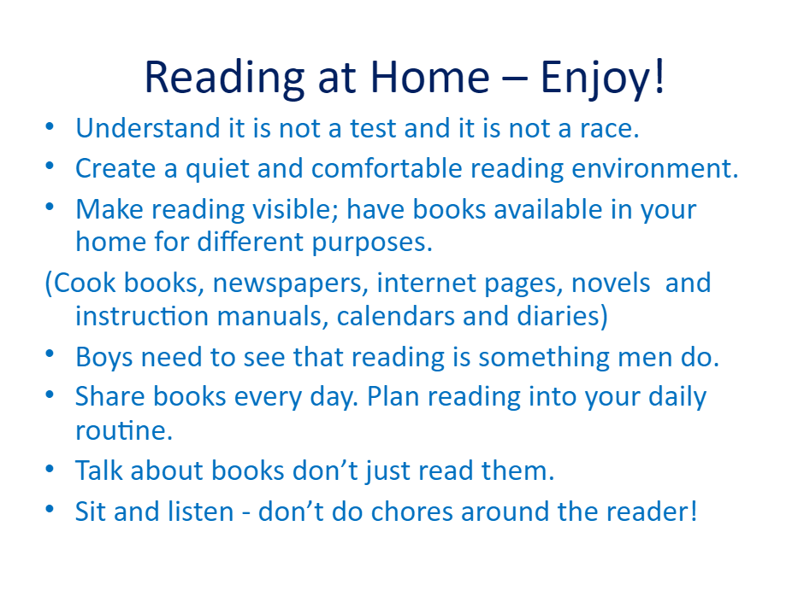

Slide 7
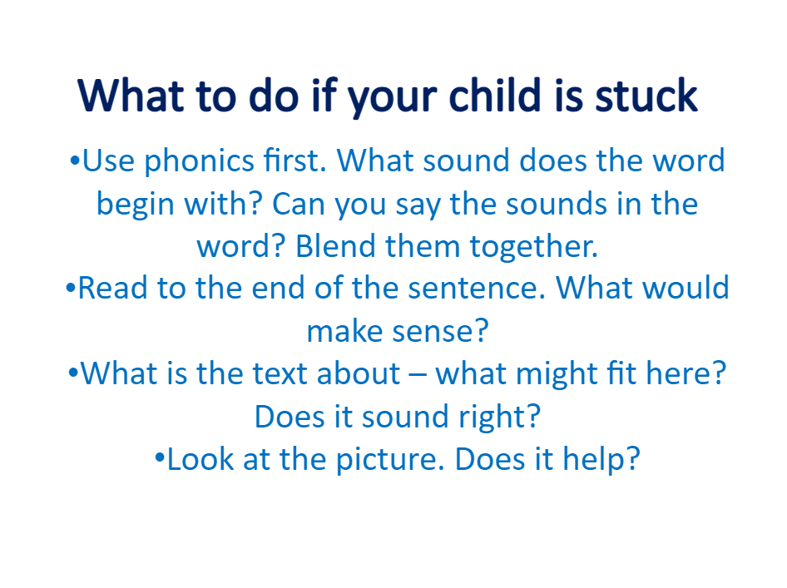

Slide 8
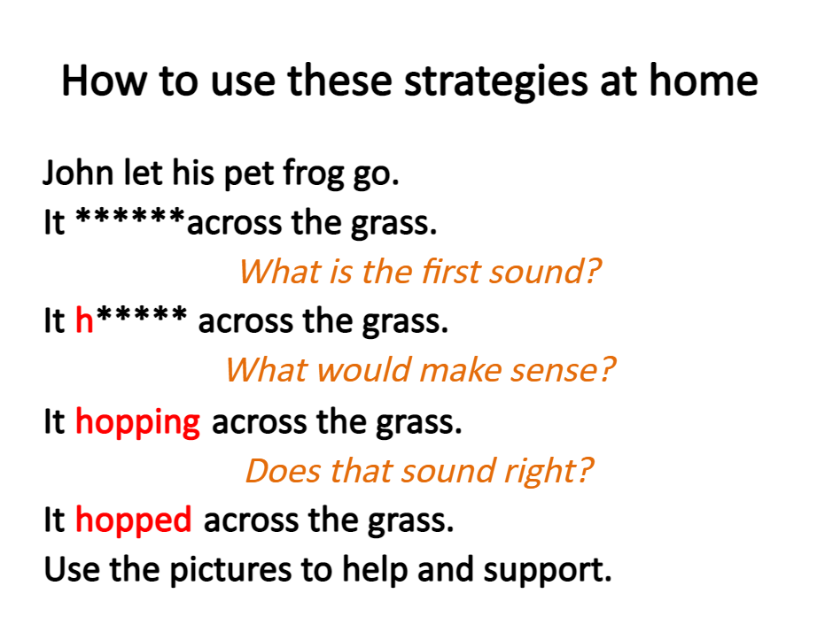

Slide 9
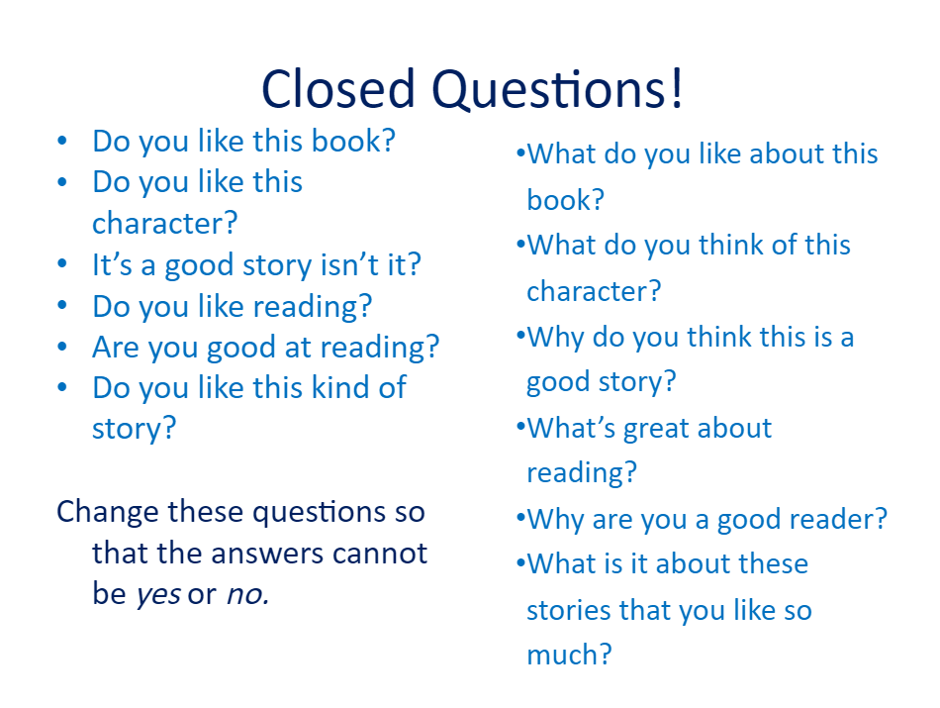

Slide 10
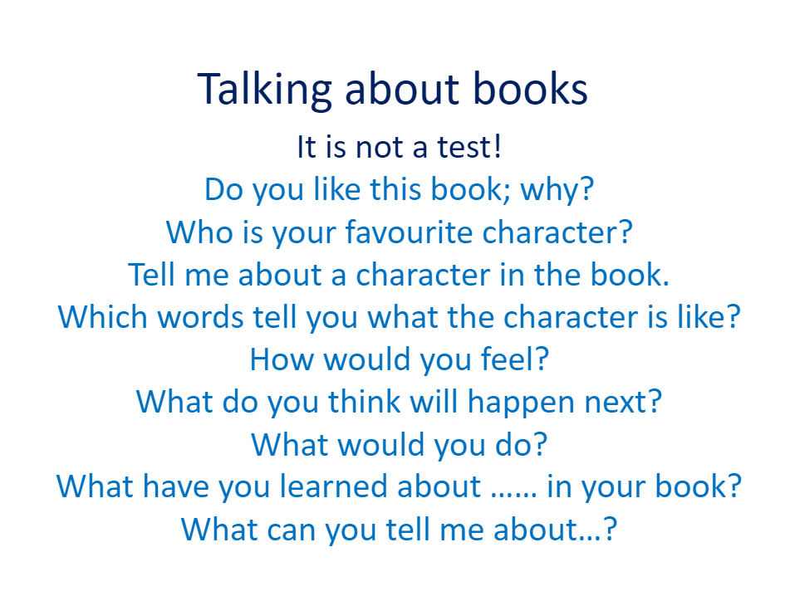

Slide 11
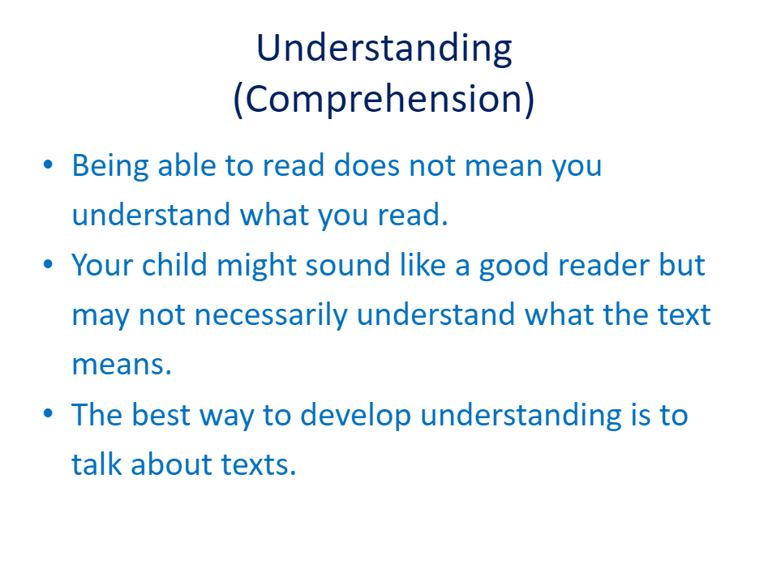

Slide 12
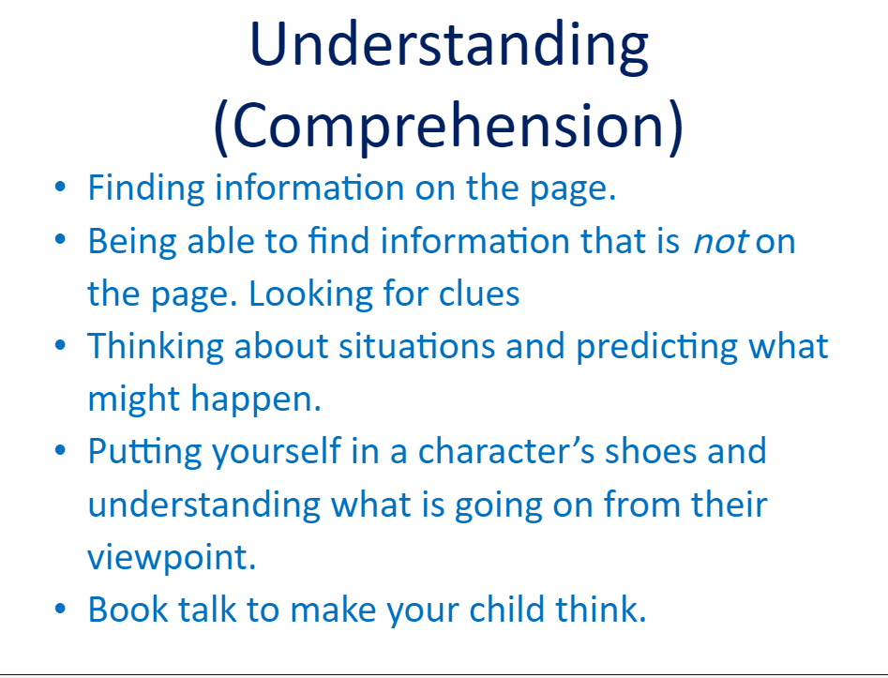

Slide 13
In the morning, Pauline immediately spotted her friend Susie’s new school bag. It was a rucksack type but not a silly pink and childish thing like her own. When her father was back from work, she asked him if she could join him on his shopping trip into town. She knew that there were lots of shops just next to the supermarket (Waitrose) where he always shopped.

Slide 14
1.What colour was Pauline’s school bag?
2. What sort of bag is Susie’s new school bag?
3. What colour bag does Pauline want to get?
4. Why does Pauline wish to accompany her father into town?
5. What sort of shop does Pauline really want to go to?

Slide 15
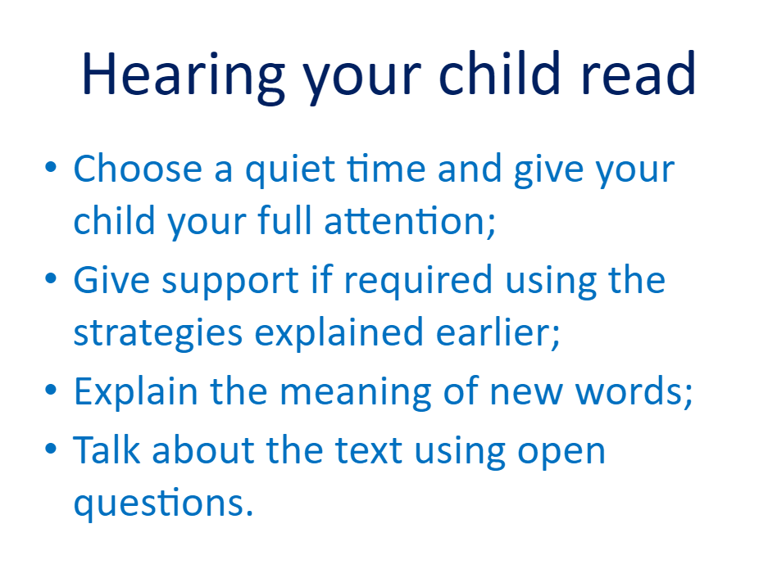

Slide 16
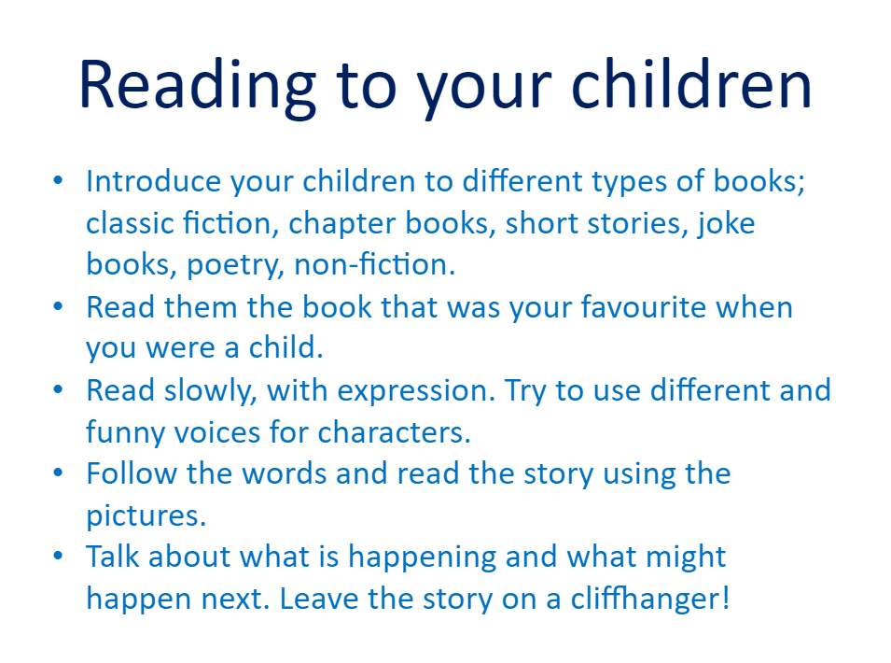

Slide 17
Thank you for taking the time to come this morning and we really hope it has been useful.
We would like to invite you to the next reading event, ‘Bedtime Stories’
on Tuesday 12th October from 5-6pm.
Don’t forget to wear your pyjamas!!!!

