Slide 1

Let’s get Reading
Supporting Reception parents at Castle Hill Primary

Slide 2


We use Oxford Owl and Floppy’s Phonics to teach your children the alphabet code.

Slide 3
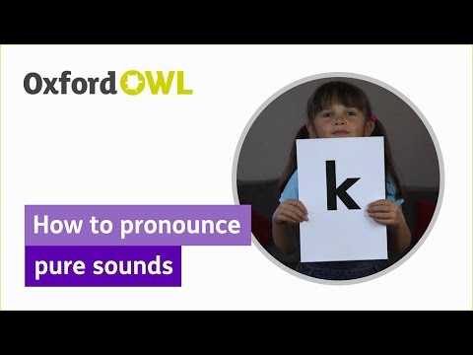
Your child will learn to recognise and say the sounds when shown the written letter shape (the grapheme)
Follow the link to watch how important
it is to say the ‘pure sound’...

Slide 4
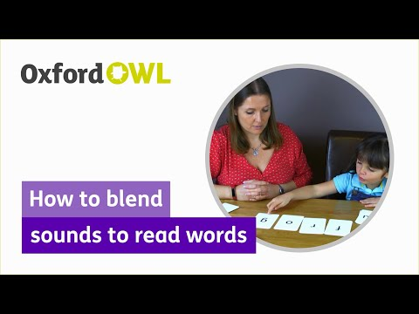
It is vital to learn these sounds so that your child can decode and blend simple words
Follow the link to watch how reading is
developed with accuracy and confidence.
NO Guesses!

Slide 5
In Reception class we start by teaching Phase 2 phonics-which introduces simple letter-sound correspondences. As each set of letters is introduced, children are encouraged to use their new knowledge to sound out and blend words. For example, they will learn to blend the sounds s–a–t to make the word sat.
Set 1:
s, a, t, p
at, a, sat, pat, tap, sap, as
Set 2:
i – it, is, sit, pit, tip
n – an, in, nip, pan, nap
m – am, man, mat, map, Tim
d – dad, and, sad, dim, Sid
Set 3:
g – tag, gag, sag, gas, pig
o – got, on, not, top, dog
c – can, cot, cop, cap, cod
k – kid, kit, Kim, Ken
Set 4:
ck – kick, sack, dock, sick, pocket
e – get, pet, ten, net, pen
u – up, mum, run, mug, cup
r – rip, ram, rat, rocket, carrot
Set 5:
h – had, him, his, hot, hut
b – but, big, back, bed, bus
f, ff – of, if, off, fit, fog, puff
l, ll – let, leg, lot, bell, doll
ss – less, hiss, mass, mess, boss
Phase 2 tricky words:
the, to, no, go, I, into

Slide 6
In Phase 3, children build on the letter-sound correspondences learned in Phase 2. They learn consonant digraphs (sounds made up of two letters together such as ‘ch’ or ‘ll’) and long vowel sounds (such as ‘igh’ or ‘ai’).
Set 6:
j – jet, jam, jog, Jan
v – van, vet, velvet
w – wig, will, web
x – fox, box, six
Set 7:
y – yes, yet, yell
z – zip, zig-zag
zz – buzz, jazz
qu – quit, quick, liquid
Consonant digraphs:
ch – chip, chat, rich
sh – shop, shed, fish
th – thin, moth, that
ng – ring, thing, song
Vowel digraphs and trigraphs:
ai – rain, tail, aim
ee – bee, leek, see
igh – high, sigh, might
oa – boat, toad, foal
oo – boot, food, moon
oo – book, wood, foot
ar – park, art, car
or – for, torn, fork
ur – hurt, fur, surf
ow – cow, owl, town
oi – coin, boil, oil
ear – dear, shear, year
air – fair, pair, hair
ure – sure, pure, manure
er – dinner, summer, letter
Phase 3 tricky words:
he, she, we, me, be, was, you, they, all, are, my, her

Slide 7
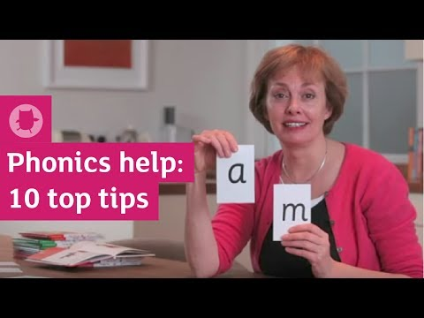
Top Tips for practising reading at home
If Possible…
Daily for 10 minutes
Comfortable
Quiet
Enjoyable and successful
Fun & engaging
Reading to your child is
FANTASTIC PRACTISE!!!

Slide 8
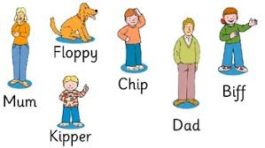
Floppys Phonics Fiction and Non-Fiction books are fully decodable
Floppys Phonics books are matched to your child's phonic knowledge
You will have 2 or 3 texts weekly to practise, which is perfect for increasing fluency and confidence
The characters...

Slide 9

Thank you for taking the time to watch this presentation...
Most of this information has been shared from the Oxford Owl Parents pages.
More information can be found at
Oxford Owl for Home: help your child learn at home
Free reading ebooks are also available
https://home.oxfordowl.co.uk/reading/free-ebooks/

