Slide 1
Does Castle Hill get you ready for your grown-up life?

Slide 2





We learn manners at school…
We learn about
being fair…
How to be kind…
We are more than a school…
We are like a really big family
or friendship group.
Our own community
…Like a massive
Whats App group
We use our
packtype skills…
We listen to
each other

Slide 3

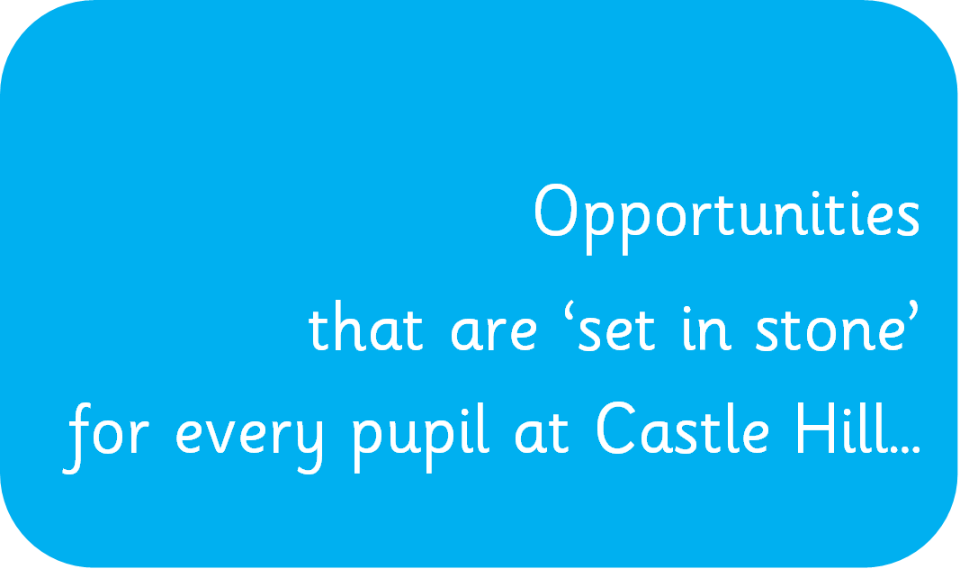


Slide 4
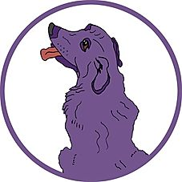


Introduction
1.Feel your right and responsibility for the wider community.
The food bank
Clubs-gym, kick boxing, dance
Church links
Open the Book
Poppies around Brockworth

Slide 5
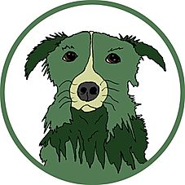

Introduction
2. Appreciate self-awareness by an overnight stay away from family.
Farm stay
Field stay
Y6 Residential

Slide 6

3. Learn the skills to save a life.
75% of KS2 pupils
DR ABC (D)

Slide 7
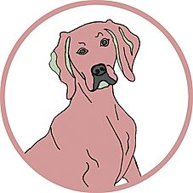

Know your voice counts by visiting the Houses of Parliament.
Enterprise project
fundraising
Elections
Our history making…

Slide 8
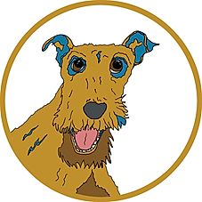
5.Take considered risks at Forest School.
Thinking before doing
Being safe
Challenging yourself

Slide 9
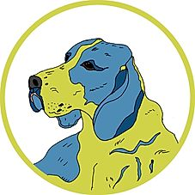
6.‘Schmooze’ to engage visitors.
‘Visitors’ teams
Engaging
Polite and representative
salespeople

Slide 10
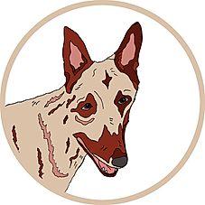
7.Compete against other schools to experience highs and lows.
Football
Netball
Cross country
rugby

Slide 11
8.Recognise the value of practice by playing an instrument.
Drums
Clarinet
New skills
Try new opportunities
perform

Slide 12
9.Be prepared to come out of your comfort zone to perform in front of an audience.
Assemblies and festivals
School Council
Nativity
Young voices
Plays and playing instruments

Slide 13
10.Understand the financial implications of an activity and take part in an enterprise project to support costs, as well as, giving a percentage to charity.
Enterprise projects
Lion King
Foodbanks
Red nose day/ Spotty socks/ Children in Need/
Christmas Boxes/ PAWS

Slide 14
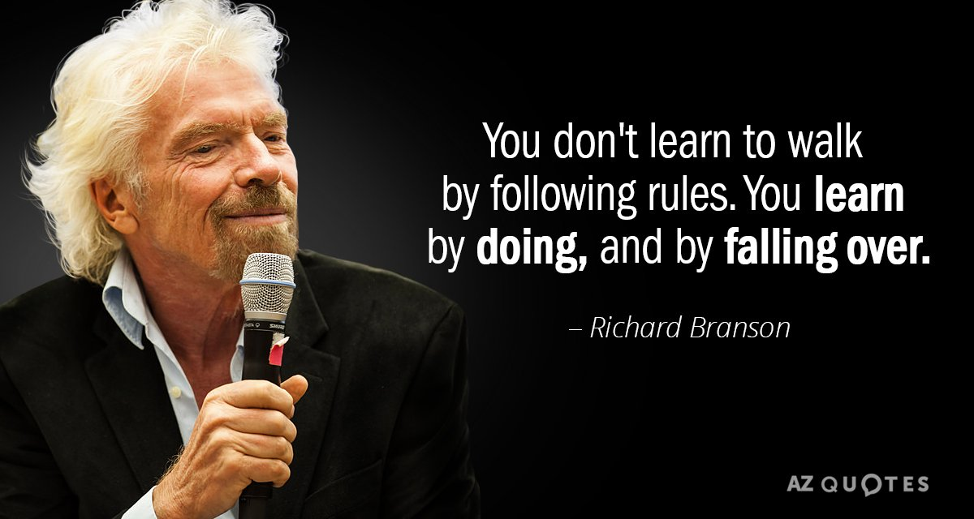
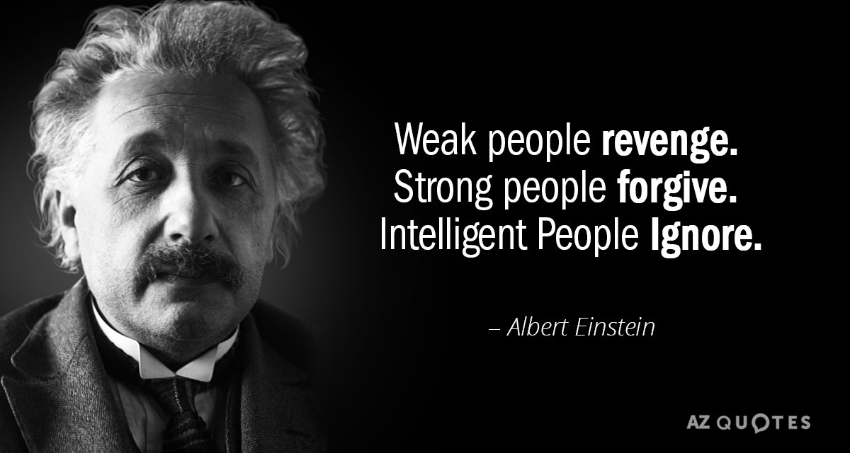
“Education is what remains after one has forgotten what one has learned in school.”
Albert Einstein
“Do with not for.” CHPS

Slide 15
Thank you

