Slide 1

Maths Parent Workshop
Friday 22nd November 2024

Slide 2
Discussion Points
White Rose Maths
Yearly Overview
Autumn Term
Spring Term
Recall Tests
Support at Home

Slide 3

White Rose Maths

Slide 4
White Rose Maths
Putting number first. The White Rose Maths schemes place the importance of number at the front of all its learning. A large proportion of time is spent helping the children to build competency and ensure children know the number bonds confidently to access all areas of the curriculum.

Slide 5
White Rose Maths
Depth before breadth. The White Rose Maths schemes allow children the opportunity to acquire a depth of knowledge in each topic, revisiting previously learned skills in later learning.

Slide 6
White Rose Maths
Fluency, Reasoning and Problem Solving. The White Rose Maths schemes develop all three key areas of the National Curriculum, giving children the knowledge and skills to become confident mathematicians.

Slide 7
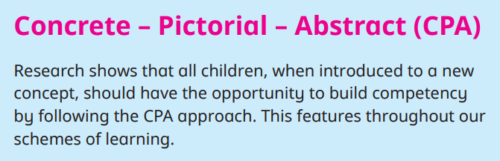
White Rose Maths

Slide 8

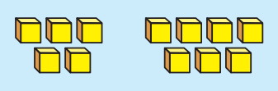




White Rose Maths
Concrete. Step One. Children are given the opportunity to work with physical objects/concrete manipulatives, in order to bring the Maths to life and to build an understanding of what they are doing.

Slide 9
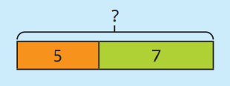

White Rose Maths
Pictorial. Step Two. Alongside concrete resources, children should work with pictorial representations, making links from what they know from the concrete. Visualising a problem in this way can help understanding.

Slide 10
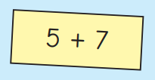
White Rose Maths
Abstract. Step Three. With the understanding of both concrete and pictorial, children can develop their understanding of more abstract methods.

Slide 11
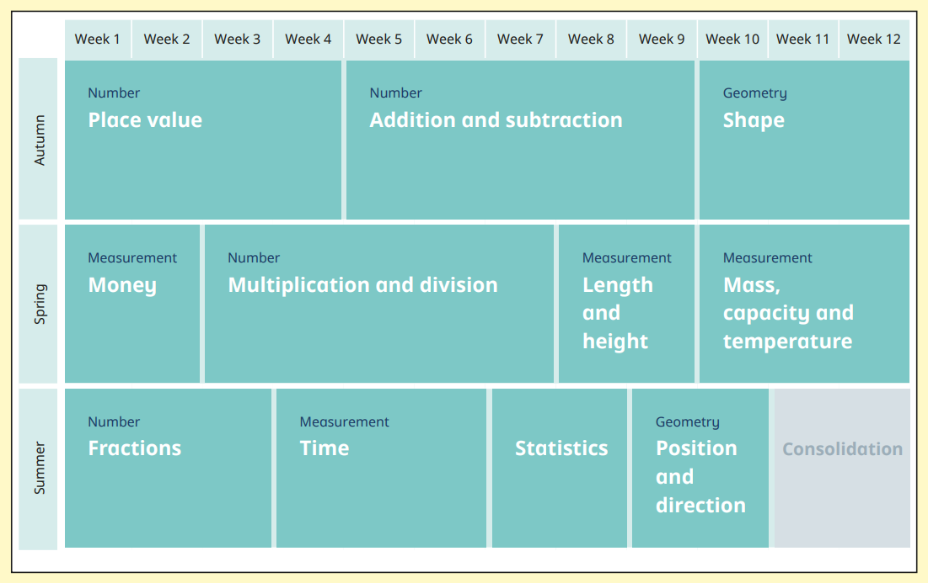
Yearly Overview

Slide 12

Autumn Term

Slide 13
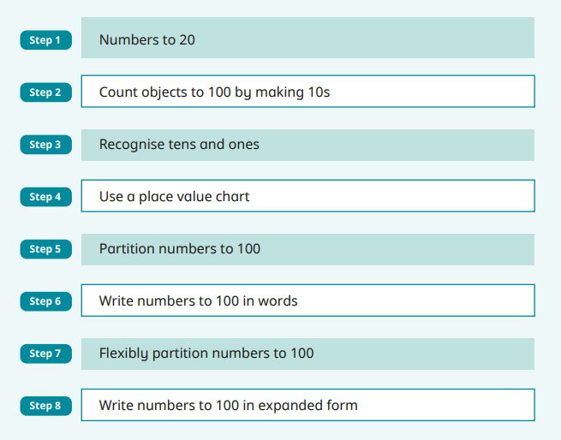
Autumn Term

Slide 14
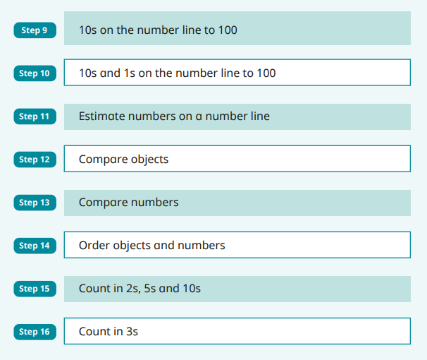
Autumn Term

Slide 15
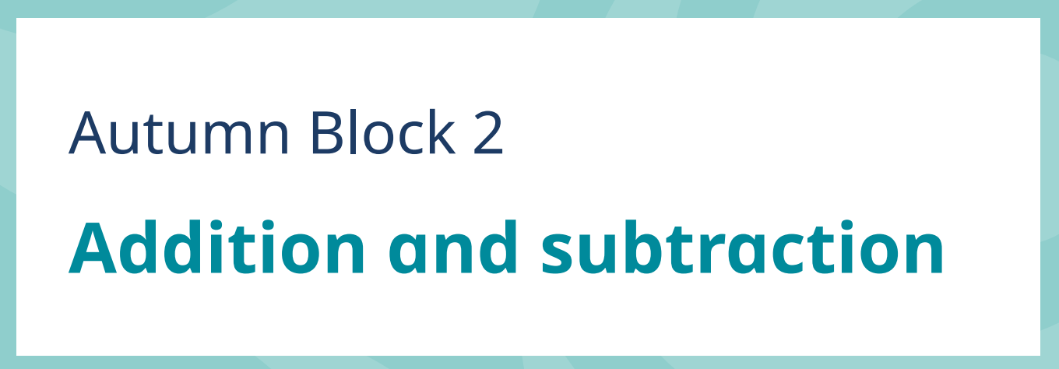
Autumn Term

Slide 16
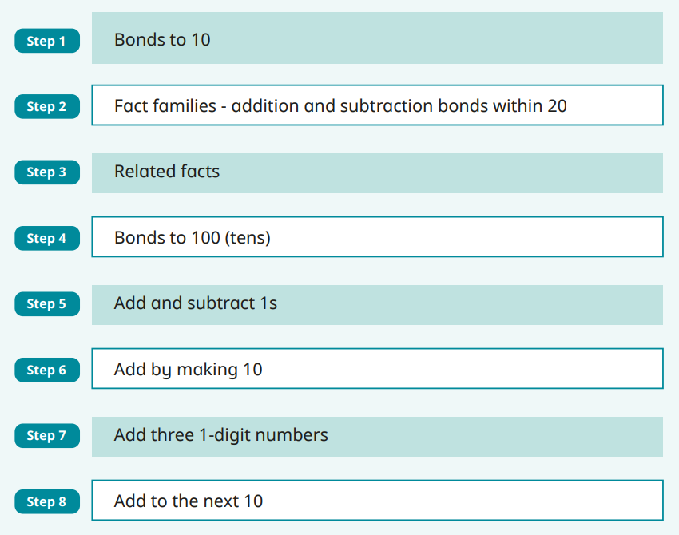
Autumn Term - Current

Slide 17
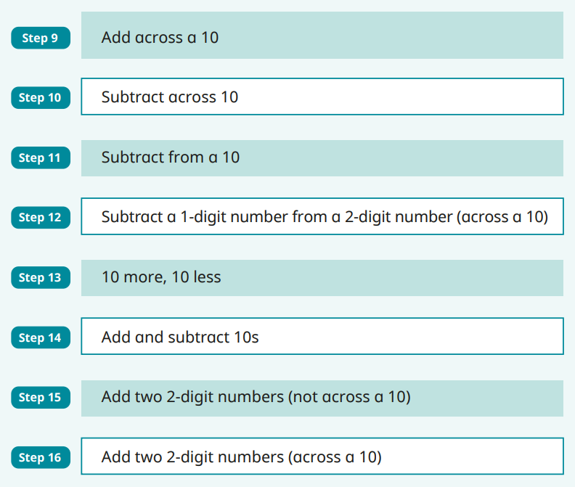
Autumn Term - Current

Slide 18

Autumn Term

Slide 19
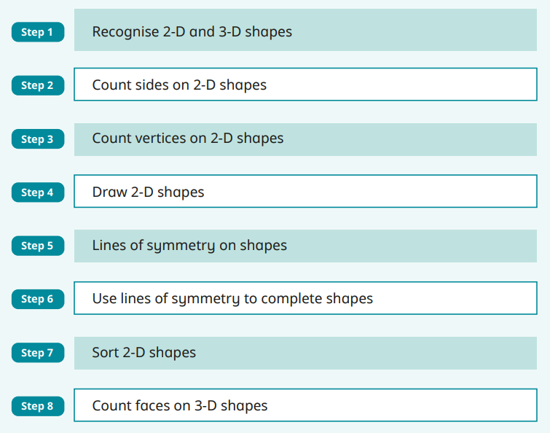
Autumn Term

Slide 20
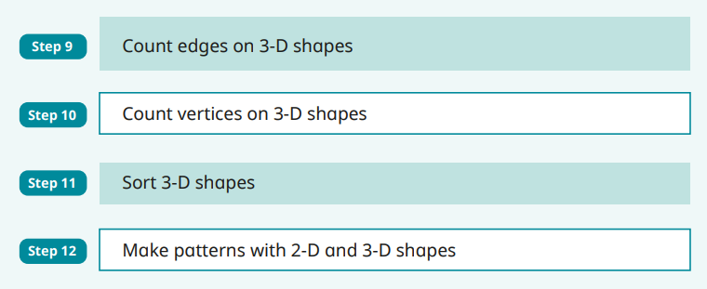
Autumn Term

Slide 21

Spring Term - Current

Slide 22
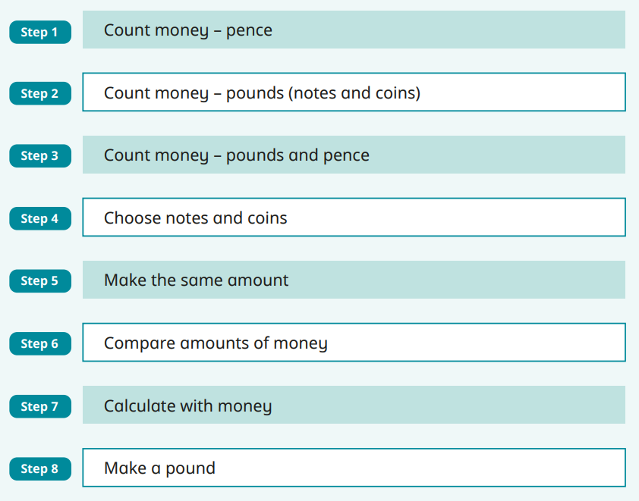
Spring Term - Current

Slide 23
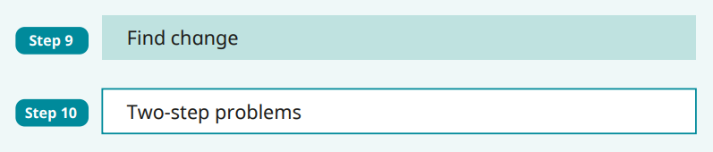
Spring Term - Current

Slide 24
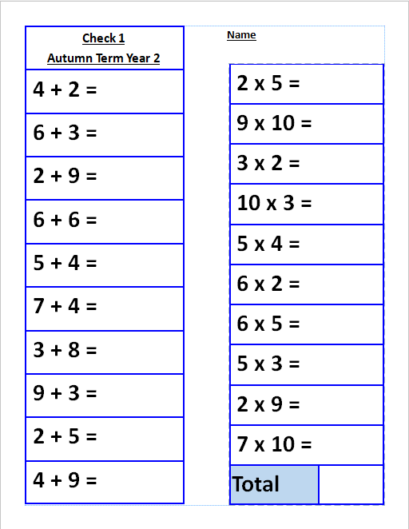
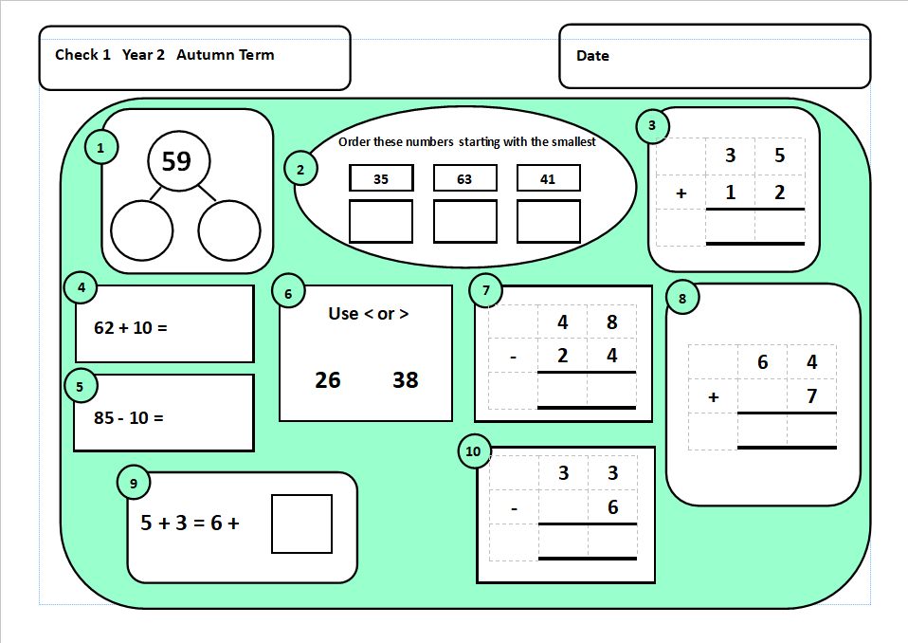
Recall Tests

Slide 25
Support at Home
Number formation
Number bonds to 10
Number recognition to 100
Recognising tens and ones
Count in 2s 3s 5s and 10s
Fact families, 1 + 3 = 4 so 10 + 30 = 40

Slide 26
Support at Home
Recognise 2D and 3D shapes
Talk about their properties
Recognising coins, knowing their value and adding values together.

Slide 27
Thank You
Any questions?

